Slide 1
Copyright © 2005 – 2006 MES-English.com

Slide 2
Do the laundry

Slide 3
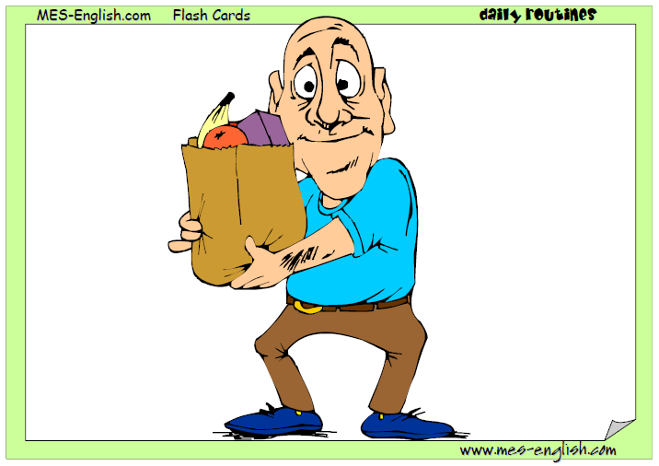
do the grocery shopping

Slide 4
Do the dishes / wash the dishes

Slide 5
Iron the laundry

Slide 6
Water the grass

Slide 7
Take out the garbage

Slide 8
make the bed

Slide 9
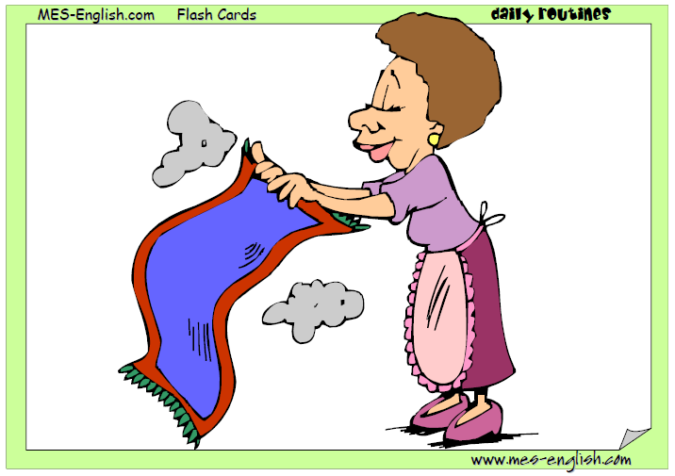
clean the house

Slide 10
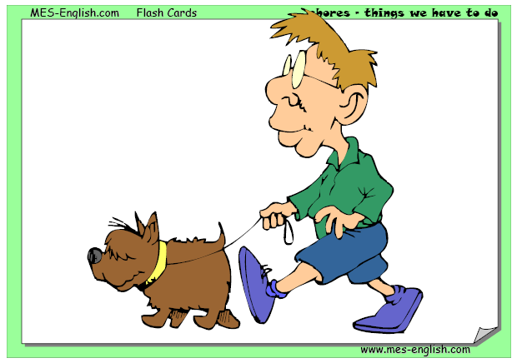
Walk the dog

Slide 11
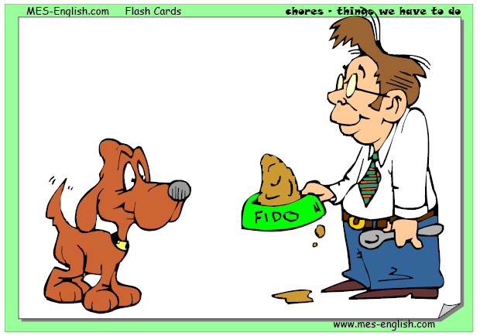
Feed the dog

Slide 12
Wash the dog

